Slide 1




SALARY PREDICTIONS OF DATA PROFESSIONS
BY: SALEM ALKOUR
DATE: 6/12/2024

Slide 2
INTRODUCTION:
Welcome to the machine Learning Intership
Focus on predicting the salaries of data professionals.
Gain hands-on experience in Data Analysis (EDA), Feature Engineering, Data Preprocessing and machine learning model development.
Our goal is to predict salaries based on dataset.

Slide 3
PROJECT PROCESS
Machine Learning Model Development
Feature Engineering
2
4
1
3
5
Exploratory Data Analysis (EDA)
Data Preprocessing
Model Evaluation

Slide 4
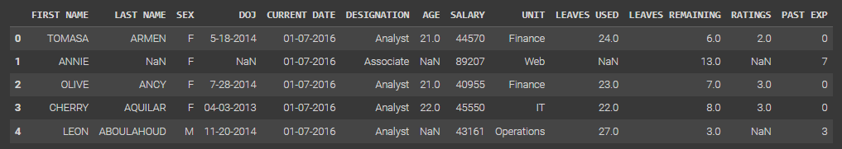
DATA SET OVERVIEW
Columns:
Our target variable: SALARY

Slide 5
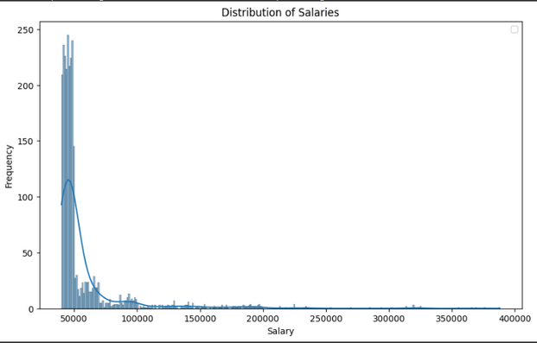
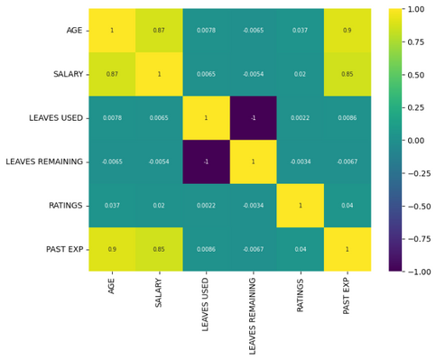
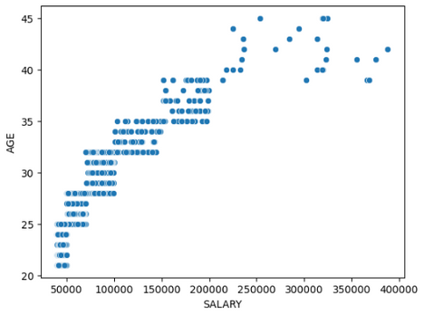
EXPLORATORY DATA ANALYSIS (EDA)
Visualize data
We used libraries like Matplotlib and Seaborn to understand the trends and relationships within the data.

Slide 6
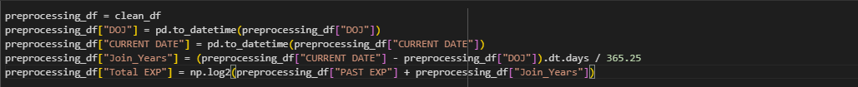
FEATURE ENGINEERING
Create new features or transform existing ones that
While analyzing the data, we discovered that we can create a new column called Total EXP that contains the past and current experience of the employee.

Slide 7
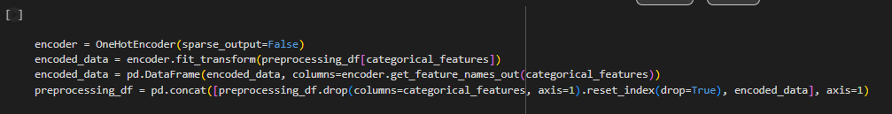
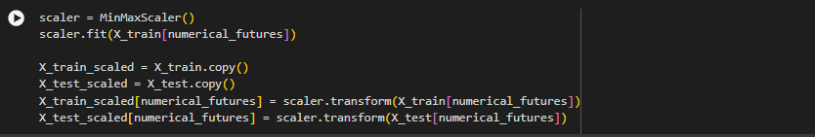
DATA PREPROCESSING
Prepare data for model training
missing values
encode categorical variable
scale features

Slide 8
MACINE LEARNING MODEL DEVELOPMENT
Train various regression models :
LINEAR REGRESSION
LIGHTGBM
SUPPORT VECTOR
XGBOOST
POLYNOMIALFEATURES
CATBOOST
DECISIONTREEREGRESSOR
RANDOM FOREST

Slide 9
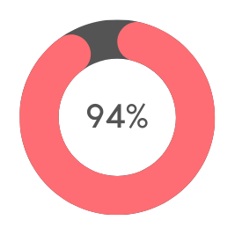
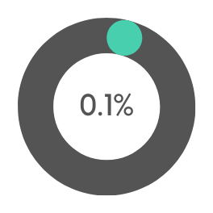
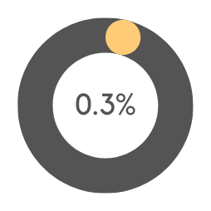
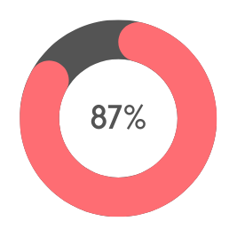
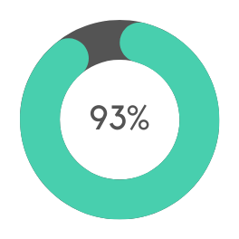
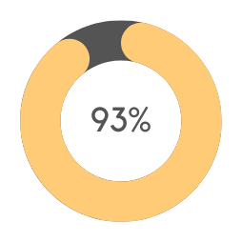
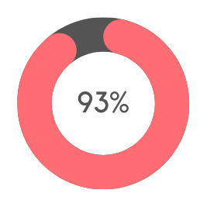

MODEL EVALUATION
Evaluate model using MAE, MSE, RMSE, R2
Example of R2-score
LINEAR REGRESSION
SUPPORT VECTOR
POLYNOMIALFEATURES
DECISIONTREEREGRESSOR
LIGHTGBM
XGBOOST
CATBOOST
RANDOM FOREST

Slide 10
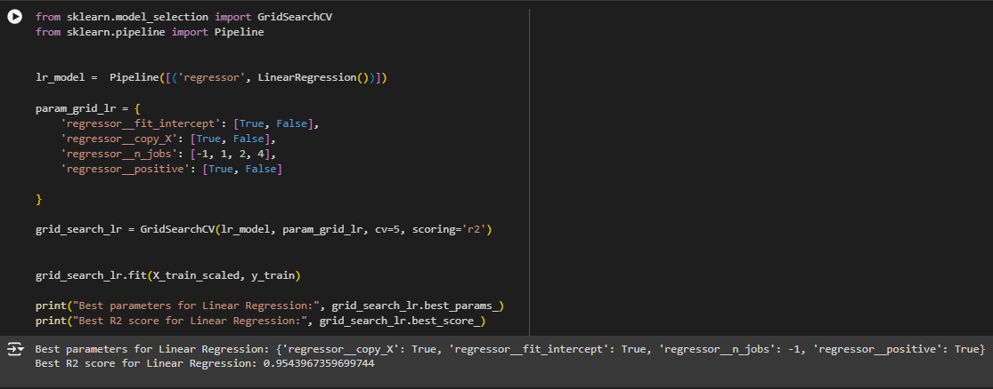
CONCLUSION
We found that the linear regression model had the best performance, with some of the tuning, the maximum r2-score is 0.954.

Slide 11

THANK YOU
SALEM ALKOUR
linkedin.com/in/salemalkour

